Slide 1
The European Forum on Urban Forestry (EFUF) and the benefits of international networking in Europe.
Clive Davies
Convenor of the EFUF international steering group
clive.davies@efuf.org

Slide 2
About EFUF
The European Forum on Urban Forestry (EFUF) is a unique meeting place for practitioners, policy-makers, managers, educators and scientists who are active in urban forestry, urban greening and green infrastructure. Since 1998, the EFUF has met annually to discuss new developments, to exchange experiences, and to visit examples of good practices on planning, design and management of urban forests (from woodland to urban parks and street trees).
The Forum is associated with the International Union of Forest Research Organisations’ (IUFRO Division 6.07.00 – Urban forestry) urban forestry group, as well as with several European and Nordic networks for urban forestry.
Participants come from across Europe, as well as from other parts of the world. Every year, the EFUF takes up an actual theme within urban forestry, such as financing, public involvement, partnerships, and management innovations.

Slide 3
Origins
Suggestion of Professor Max Krott of the Georg-August-Universität Göttingen, Germany.
The general idea was to bring together practitioners, policy-makers, managers, educators and scientists active in urban forestry on a European basis.
Previously these groups of people had rarely interacted and networking was almost entirely based on the individual European nations.
Professor Max Krott

Slide 4
The First Forum(1998) Wuppertal, Germany
Image: Wuppertal kaiserwagen: credit JuergenG

Slide 5
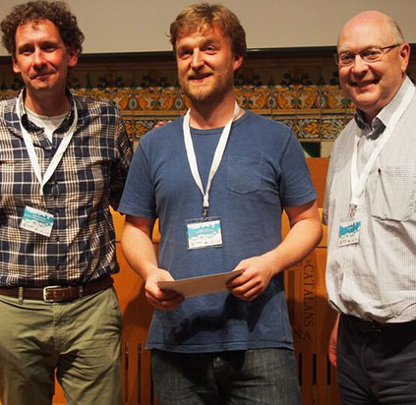
Continuity
There was no intention that the European Forum on Urban Forestry would become an annual event. However, it was so well received that many attendees stepped forward to organise a future forum.
For the last 25 years has been sustained in this way. The only notable changes being the setting up of the steering group in 2015, the cancellation of the 2020 forum in Manchester due to Covid and the organisation of the first digital forum in 2021.
Image: Cecil Konijnendijk (left), John Parker (centre), Clive Davies (right). John Parker receiving an award at EFUF 2016 in Ljubljana

Slide 6
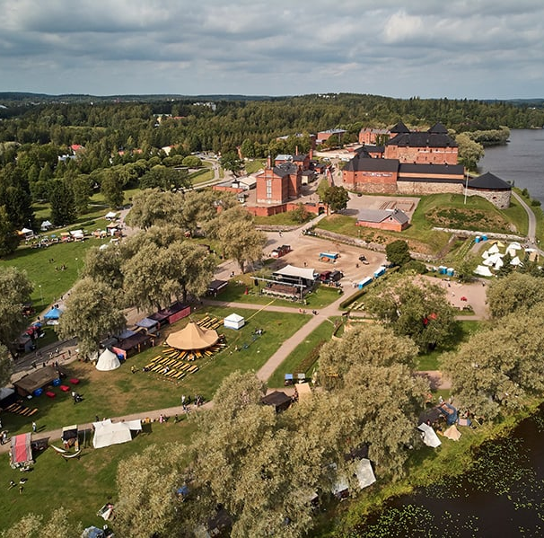
The first decade
1998 – Wuppertal, Germany 1999 – Aarhus, Danmark 2000 – Budapest, Hungary 2001 – Durham, United Kingdom 2002 – Trondheim, Norway 2003 – Arnhem, The Netherlands & Brussels, Belgium 2004 – Stockholm, Sweden 2005 – Celje, Slovenia 2006 – Florence, Italy 2007 – Gelsenkirchen, Germany 2008 – Hämeenlinna, Finland
The City by the lake - Hämeenlinna, Finland, destination for EFUF 2008. image: Visit Hame

Slide 7
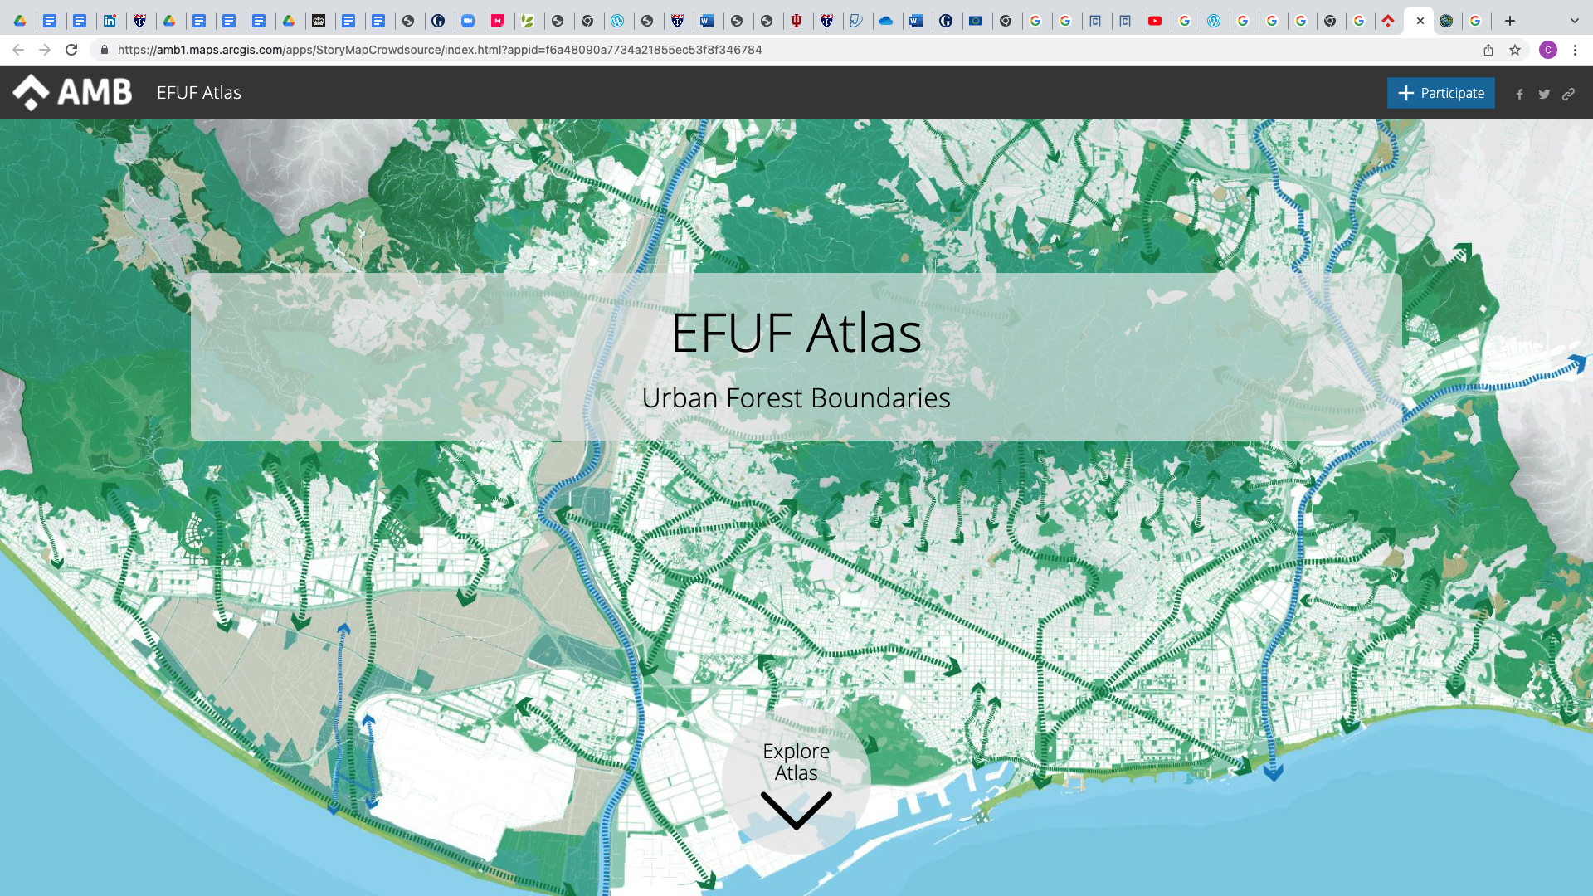
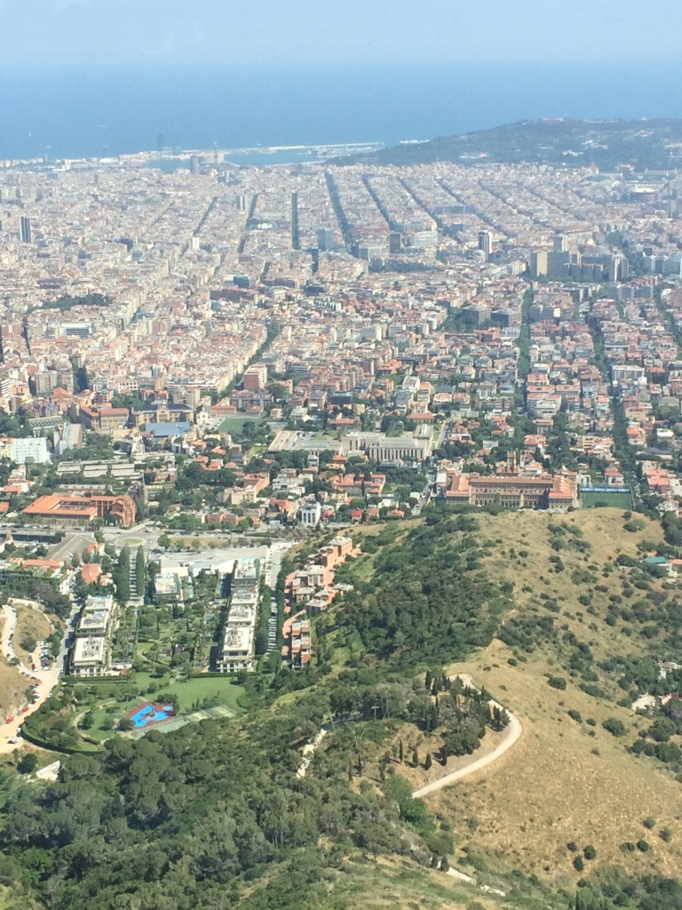
The SECOND decade
2009 – Arnhem, The Nederlands 2010 – Tulln, Austria 2011 – Glasgow, United Kingdom 2012 – Leipzig, Germany 2013 – Milano, Italy
2014 – Lausanne, Switzerland
2015 – Brussels, Belgium
2016 – Ljubljana, Slovenia
2017 – Barcelona, Spain
2018 – Helsinki & Vantaa, Finland 2019 – Cologne, Germany
Metropolitan Area of Barcelona was the venue for the 2017 forum.

Slide 8
The THIRD decade
2020 – Manchester (cancelled due to COVID-19)
2021 – First digital Forum (on-line due to COVID -19)
2022 – Belgrade, Serbia (17th – 21st May 2022) www.efuf2022.com (booking open)
2023 – Poland
2024 – Croatia
MyEFUF App was developed by our Swiss partners to support the first digital Forum. The forum is grateful to the Swiss federal office for the environment for supporting the costs of this.
EFUF as a strategic partnership with the European Forest Institute and along with the EU CLEARING HOUSE project ran the highly successful Urban Forestry days conference in March 2021
https://youtu.be/fqs0YsR9C6A

Slide 9
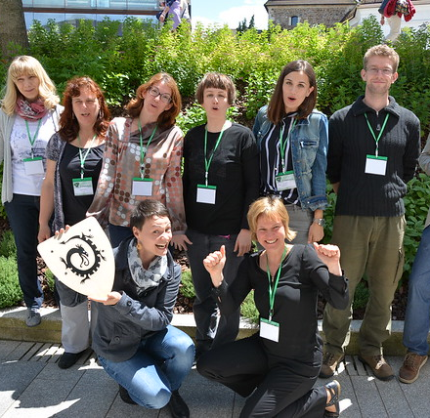
Each Forum
The forum normally takes place in the month of May and is organised locally.
The forum includes plenary sessions, parallel sessions, demonstrations, field trips and social activities.
A high priority is given to networking and to the mixing of new and long-standing attenders.
An award is given called the Young Urban Forester of the year award to celebrate upcoming talent.
The early forums were attended by tens of people but now usually well over 100. The EFUF mailing list is over 1,000 most of whom have attended at least one forum.
Picture: The EFUF communications team at EFUF 2016

Slide 10
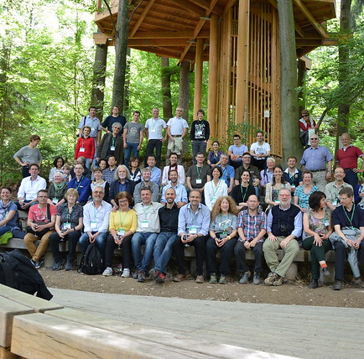
Fun and family
Urban forestry can be a serious business full of challenges.
The forum is however a place for fun as well as knowledge exchange. It has established many working partnerships and lifetime friendships across international boundaries.
It has also been described as a family as those working in urban forestry often find themselves professionally isolated. It is also generated a significant and much valued European identity for urban forestry - one that did not exist before and is unlikely to have been created other through the organic evolution of EFUF.
10 years 2005 – 2016. Ten-year reunion in Slovenia.

Slide 11
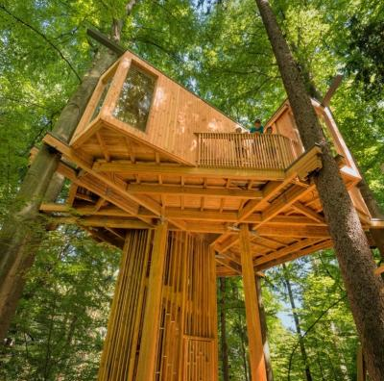
Our logo
The EFUF logo is based on the:
Drevesna hiša (tree house)
City of Celje, Slovenia
Host of the 2005 EFUF
Image: celje.si

Slide 12
Achievements
EFUF has influenced and inspired many things:
A close partnership with the European Forest Institute, IUFRO, ArboCityNet and many others.
Partnered in research projects such as China-Europe CLEARING HOUSE project.
Stimulated inter-city collaborations such as that between Brussels Capital Region, Barcelona metropolitan area and the city of Ljubljana for EU Green Week 2021.
Piloted new ideas such as Actionbound tree discovery walks. e.g.
https://en.actionbound.com/bound/aTreeAwakeningBrusselsCapitalRegion
Launched urban forestry podcasts on Spotify.
https://open.spotify.com/show/5g9OLDQtrHThjcScT0rmPO
MOST OF ALL – achieved its aim to unite practitioners, policy-makers, managers, educators and scientists and forge a Europe wide urban forest identify.

Slide 13
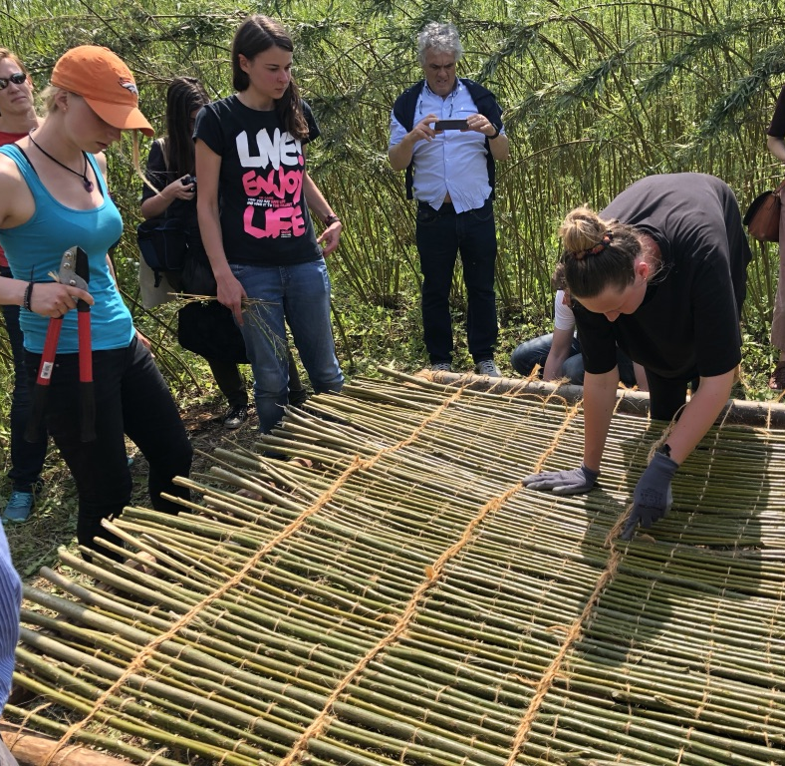
Young people in urban forestry
EFUF gives every opportunity to young people across borders starting in urban forestry to become involved on equal terms. Listen to the words of this video made by the International forestry students Association.
https://youtu.be/dlU0Pyzzrh8
Image: International student camp at EFUF 2019, bringing young people together helps to build understanding across countries and forest ecosystem solidarity.

Slide 14
Beyond Europe
EFUF has always welcomed attendees from every part of the world.
We have been delighted to see, inspire and contribute under the leadership of UN FAO to the growth of urban forest forums across the world.
EFUF was delighted that FAO decided to hold the first world Forum on Urban Forests in Europe in 2018.
The EFUF steering group wishes to assist global initiatives that support urban forestry as we believe that trees and forests in and around cities are essential to human health and well-being in this century.

Slide 15
Research
EFUF provides a network for research activities. The forum is active in the China-Europe CLEARING HOUSE project.
This project is investigating the role of urban forests is a nature-based solution as a means to improve urban living in both Europe and China.
https://clearinghouseproject.eu/resources/

Slide 16
Coming soon
EFUF 2022, 17th – 21st May Belgrade, Serbia. Booking open – you are welcome.
A new website
More Podcasts
Incorporation and membership
https://youtu.be/BJ-gtcO6RAM

Slide 17
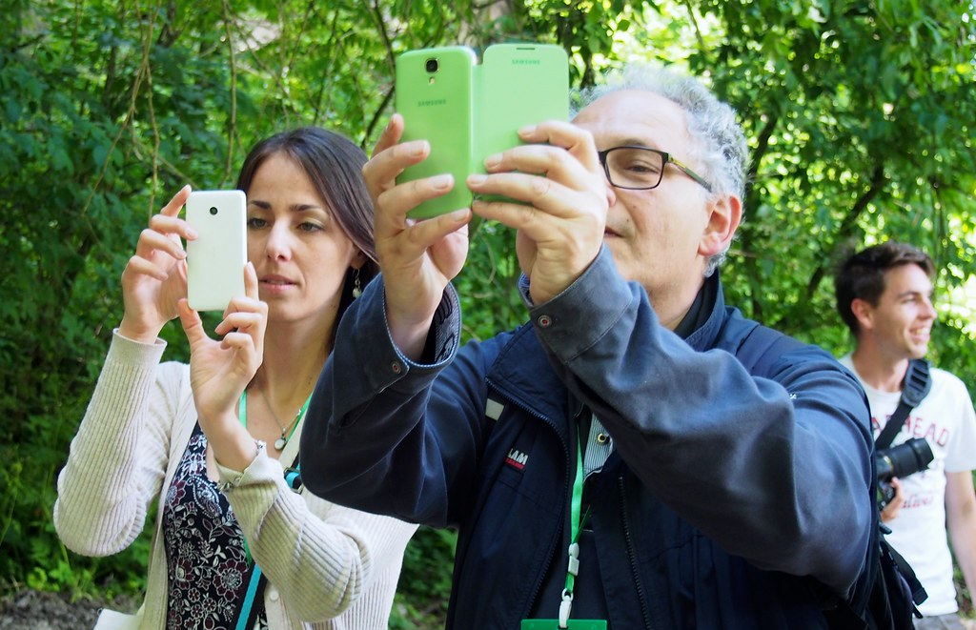
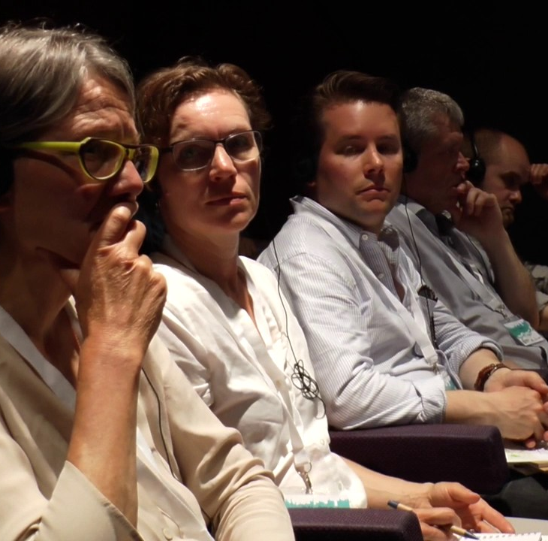
Thank you for listening
You're Welcome
at EFUF

